Slide 1
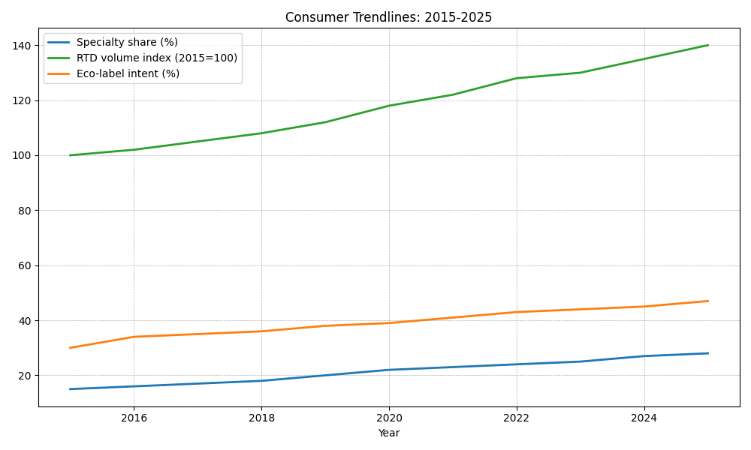

Consumer Trendlines
Specialty share rising (+2–3 pp over 5 yrs).
Ready-to-Drink (RTD) CAGR ~8–10% (global).
Eco-label purchase intent ~+12 pp since 2018.
At-home brewing upgrades post-2020; grinder/espresso penetration up.
Plant-based milks in coffee: double-digit growth; sustainability cited.
Price sensitivity: at-home demand elasticity ≈ -0.6; out-of-home ≈ -1.1 (indicative).

